Slide 1
Events
IN710 OOSD 2017
Session 8.1
Notes:
There are a number of things in .NET that are implemented with delegates, and we’re going to look at some of them over the next two weeks.
This week we start with the most important one – the .NET event model.
This is how we can have things like GUIs and timers and background processing and so forth.
Events are raised in response to user actions, system state, etc., and code is executed in response.

Slide 2
Supporting Communication
Subject-Observer pattern
Events
Subjects expose events
Observers declare methods they wish to have executed when an event occurs.
Observer code can be bound to Subject events as delegate instances.
Notes:
The Events model is .NET is an extension of the Subject-Observer pattern
The most familiar place that we see Events in .NET is in UI, like button click handlers. In these cases, the Button object is the Subject and the code you write for it is made into an observer and subscribed to the Click event. When the user clicks on the button, the System raises the Click event, and your code is executed.
However, any object can define its own events, have its own observers and raise its events when it wants to. That’s what we will look at today. You will then be able to understand much better how button click handlers work.
The syntax for this is fairly complex.
We need to know how to expose these events.
We need to know what delegate type(s) we can use.
We need to know how to get the binding done.
We need to know how to raise the events.
We will look at all of these things – both architecturally (who does what) and syntactically (how they do it).

Slide 3
The Subject (Publisher)
Declares a delegate type and an event which is bound to that delegate type.
Notes:
The syntactic rules are very specific. We will see them in a bit.

Slide 4
The Observer (Subscriber)
Observers declare a method they wish to have executed when the event occurs.
The method must match the delegate type bound to the event.
Observers must have access to the Subject instance.
Observers can subscribe themselves to the event, registering their method.
There may be many Observer methods registered to a single event
Notes:
Observer
So a difference here from the classic S-O pattern, in that Observers don’t just call mySubject.Add, they explicitly subscribe to a particular event.
Note that this allows a single Subject to server multiple distinct groups of Observers, rather than just a single group as with the simpler version.

Slide 5
The Event
When the time is right, the Subject “raises the event.”
All subscribed methods are executed.
Notes:
Syntax in a moment
The methods are executed in order, sequence undefined
For system events, like mouse_clicks, timer_ticks, Form_Load, etc. there are slight differences:
For these system events, we don’t create a subject, the events are raised by the operating system when the mouseclick is detected, the timer interval has passed, etc.
But the rest of the logic is the same.
We will look at the special issues around system events later.

Slide 6
The Subject - Declaring the delegate type
Delegate types for events always specify the same method signature:
Return type is void
Arguments are:
object
EventArgs or descendent
Notes:
EventArgs is a system class for holding information – basically a data bag. We will discuss it in a second.
The second argument of a delegate for a user-defined event must be either EventArgs or a descendent of EventArgs (custom or system). So if the base EventArgs class, or one of the system EventArgs descendents don’t hold all the data you need, you can simply descend your own.
You might wonder, since the method signature is always the same, why we have to define a new delegate every time. => It’s because of this EventArgs.
If your event will work with one of the system-defined EventArgs classes, you can use one of the pre-defined event delegate types. Examples in a moment.
But if you need a custom EventArgs, you will have to define your own delegate type.
(NB: There is another syntactic alternative that we will see later that allows us to avoid having to define our own delegate type in some cases even when we need a custom eventArgs. We start with this more basic approach because it’s clearer.)
Every method written (by an Observer) to respond to an event must, therefore, have this prototype, even if it’s not really convenient (for example, even if they don’t need any eventArgs information).
Can you see why they’ve made it this way?
It allows all events to use the same interface. Cf. the problem we had with our update() method in your IObserver interface. Once it needed three integers (the weather data), once it needed one integer (the RPM in the bicycle application). So we had to write it twice.
Here, that’s not a problem.
So we sacrifice specificity to gain generality

Slide 7
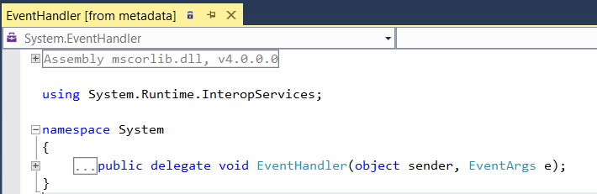
The Subject - Declaring the delegate type
Delegate types for event handlers always specify the same method signature: return type is void; args are object & EventArgs or descendent)
Notes:
Summarised from the previous slide
Here is the generic system event delegate type (note the namespace).
Note that it matches the pattern. Note that lots of event handler methods you have written (e.g. every Form_Load) match this pattern, so that they can be made into instances of the delegate type EventHandler.
You can use this delegate type to bind methods to events (syntax for declaration and binding still to come) if the base class EventArgs is all you need (recall that it is empty – so this means that you don’t need to pass any data to your Observer.)
If you are writing an observer for a system event, you use the delegate type with the EventArgs descendant for that event. There are 100s of them.
The Form_Load and Button_Click events use the generic one, but here is an example of an event that uses a descendant.
Recall that the base EventArgs is actually empty – it has no data. That’s fine for the Form_Load and Button_Click, because there is no useful information associated with those events (that is, all that matters is that the button was clicked or the form created).
But for the mouse-down, there is additional useful information, specifically, the location where the mouse was clicked.
The system wants to pass that in to the event handlers so it can be used there.
You therefore require an extension (descendent) of the empty EventArgs base class that holds two integers, x and y. That is exactly what MouseEventArgs is.
If you are writing a custom event, and you need to pass data, you will need to descend a custom EventArgs child. We will see how to do this, but it’s just normal descent – you already know how.
Assume you have done this, creating a descendent called CustomEventArgs. Your subject could then declare a delegate type suitable for event handling, like this…
Note that it matches the required pattern: returns void, accepts and object and a member of the EventArgs family.

Slide 8
EventArgs
The system base class EventArgs has no data and no methods.
If you don’t want to pass any data to the event handler, you can use this base class and the generic event handler delegate type (you don’t need to declare your own).
If you wish to pass data you can create your own EventArgs descendant and give it the necessary additional data fields.
When handling system events, you can use an appropriate system descendant of EventArgs.
Notes:
Summarising...

Slide 9
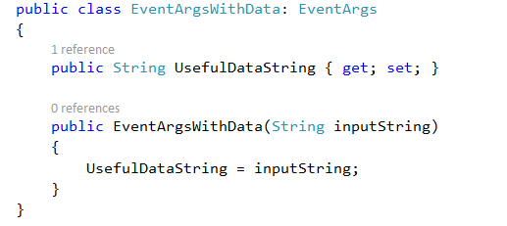
Descending a Custom EventArgs
Notes:
Here is how you would define and declare an instance of a custom EventArgs class
Just normal stuff.
I’ve given this class a read-only piece of string data.
When the Subject raises his event, he will make one of these and pass it along (syntax coming soon).
The method to whom it is passed when the event is raised (a delegate registered by an Observer) can access this data like any normal input argument.

Slide 10
The Event
public event eventDelegateType eventName
Notes:
Still on the work of the Subject….
Once you have an appropriate form of delegate (i.e. takes object and EventArgs) you can declare the event
Syntax is like this. It’s a little weird.
event is a keyword
eventName is the name by which the event will be raised and known and referred to by the observers when they subscribe
The type here looks like “the type of the thing called eventName”, but it isn’t.
The type is “the type of delegates that may be bound to this event.”
This can be either a delegate type you have declared, or an appropriate system delegate.
In either case, it must specify the correct method signature for working with events: return void and accept one object and one EventArgs (or descendant).

Slide 11
The Event
Assume this delegate type declaration is in scope:
The Subject class can declare an event:
Name of the event
keyword
Delegate type that can
be bound to this event.
Notes:
You need to pass data to your observers, so you descended from EventArgs and declared this delegate type. It matches the allowed pattern for binding to events.
This event type would generally be declared in the class who was serving as the Subject in the Subject/Observer pattern.
That is, the guy who is going to raise the event.
Here is the code..

Slide 12
The Observer
Assuming the Subject has exposed an event, and an Observer has access to a Subject instance, the Observer can register a method to be executed when that event is raised.
Syntax:
EventDelegateType del = new EventDelegateType(observer’s method);
subjectInstance.EventName += del;
The Observer's method must, of course, match the delegate signature
Note that if you declare the delegate and event inside the subject class, you will need to fully qualify the event handler delegate type name.
Notes:
The observer’s method must match the delegate signature, which will be “returns void, accepts object and EventArgs or descendent”
We will look at some examples….

Slide 13
Event Binding
An event can take multiple delegates.
The “+=“ adds the provided method delegate to a list of delegates that are invoked when the event occurs.

Slide 14
The Subject
Raising the event
When conditions require it, the event is “raised” by the Subject.
This is a two-step process
Prepare the EventArgs object
Raise the event
Notes:
This looks much like the call of any function
The syntax allows the eventArgs object to be passed to the registered Observer methods.
We will see the syntax in just a minute

Slide 15
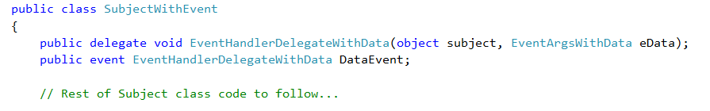
Raising the Event
Notes:
Here is the code we have written so far...
Note that the type of EventArgs we need is EventArgsWithData, which accepts an input string
Note that the name of the event is DataEvent
Assume that some observers have subscribed to this event. The time has come to raise the event so the registered Observer methods will be executed.

Slide 16

The Subject Raises the Event
To raise the event:
Create the EventArgs:
Raise it
Notes:
Our two step process..
The object argument of an event (usually called ‘sender’) is almost always “the guy who raised the event”.
For system events, which are raised by the system, it is “the guy who exposes the event”. So, the button, the form, etc.
Here, when the subject raises his own event, he passes himself in as the first argument (the sender).

Slide 17
The Observer(s)
When the event is raised, all registered observer methods are executed.
If there are multiple registered methods, the order of execution is undefined.

Slide 18
Events
In summary:
A Subject declares an EventArgs descendant (optionally), a delegate of correct form (optionally), and an associated event
An Observer declares a method that matches the delegate signature, and creates a delegate instance from it.
The Observer registers its method with the Subject’s event.
At the right time, the Subject prepares the EventArgs and raises the event
All registered methods are executed.
Notes:
Remember if you don’t need to pass data, or can use one of the existing EventArgs children, you don’t have to create your own.
Remember that if you can use an existing system delegate type, you don’t have to create your own.
For example, if you are registering a method to a button click, you will use the already existing delegate type mouseEventHandler which uses MouseEventArgs.

Slide 19
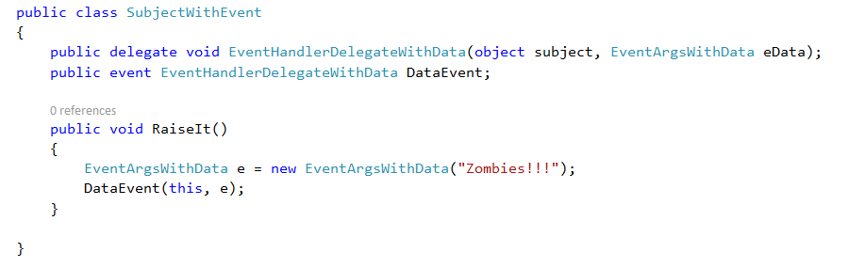
Example: The Subject Class
Notes:
We’ll take the code we have been using and put it into actual classes
First, the Subject
We’ve seen the delegate and event types already.
The EventArgsWithData class has been defined somewhere in the namespace
Now we just add a simple method that actually raises the event.
Note the two steps: Prepare the EventArgs and Raise the event (i.e. call it like a method) passing in yourself and the EventArgs.
How about the Observers? Remember they need access to the subject and a method of the appropriate signature…

Slide 20
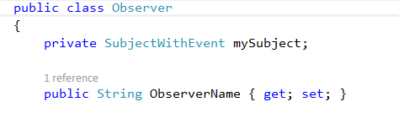
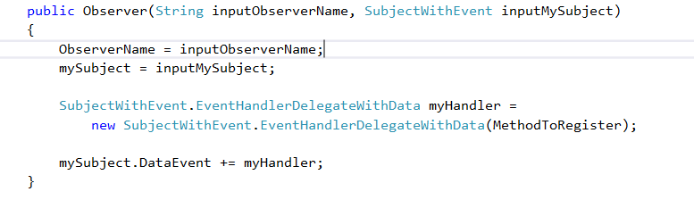
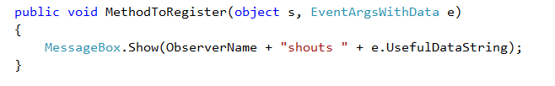
Example: An Observer Class
Notes:
Here’s the start of the class declaration.
We’ll give him a Subject reference, and just a single string field for this example.
In his constructor we will register a method to the Subject’s event.
Note that the delegate type name must be fully qualified because it is declared in the Subject class.
MethodToRegister is a method belonging to the Observer. It’s coming up in a second...
What do we know about it? What criteria must it satisfy? => return void and accept one object and one EventArgsWithData.
Why? Because that is how Subject.CustomEventHandler is defined. Check previous slide if needed.
Here is the bound method…
It’s got the right signature for CustomEvent.
Note how we access the field of the EventArgsWithData object.
If we get this all wired up correctly, this code will be executed (a MessageBox will pop up) when the Subject raises his event.
So, how do we use these classes?

Slide 21
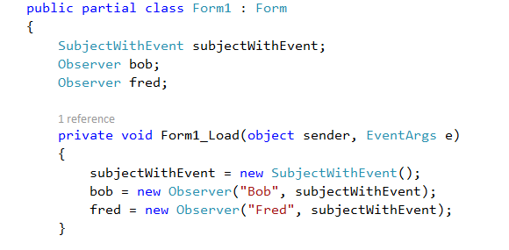

Example: Using the Classes
Notes:
We’ll use them in the Form, but you could do it just the same in any consuming class.
In the Form_Load, we create everybody.
We make the subject
We create two Observer instances. Each will register their MethodToRegister in their constructor
In a button click handler, we call RaiseIt().
Remember RaiseIt()?
Note, most importantly, that nowhere in here does the Subject attempt to talk directly to the Observers.
Unlike with our previous Subject/Observer implementation, this Subject doesn’t know anything about his Observers.
The system keeps track of who has registered a method to the event for us.
All we do is raise (call) the event, and all the registered methods magically execute.
Note also that the Form doesn’t talk to the Observers (after it creates them).
Nobody talks to the Observers.
On creation, the observers register themselves with the event, and the system takes care of all the invocation.
What happens when we click the button?

Slide 22
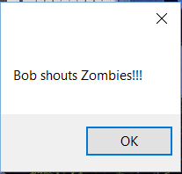
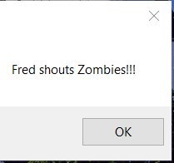
Example: Using the Classes
Notes:
Bob’s MethodToRegister will fire, then Fred’s.
(NB: Usually event handlers fire in the order of registration, but this is not guaranteed. If you are using shared state, be careful.)
Because we are using MessageBox.Show, which is modal, this is how it will actually happen.
But remember that the order and timing of execution is undefined.
If there is any possibility of confusion when all of the registered methods execute, the developer is responsible for keeping it safe.
We will see how this is done later in the semester.

Slide 23
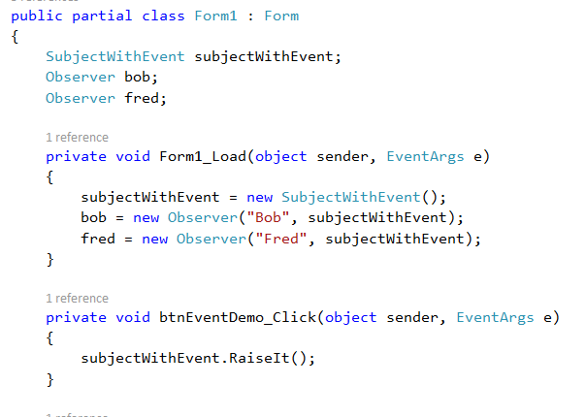
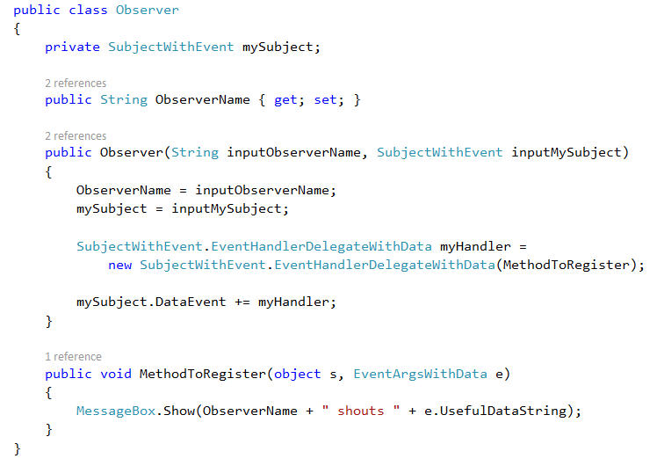
Example: Using the Classes
Notes:
Here’s all the code.
Imagine I have 100 observers that I want to fire like this, instead of just 2
What changes to do I make in the Subject class => None
What changes do I make in Observer class? => none
and the Form? => just add more Observers as required in the Form_Load. The button click handler doesn’t change.
Do I need additional Subjects? No. As many Observers as you want can register to a single Subject.

Slide 24
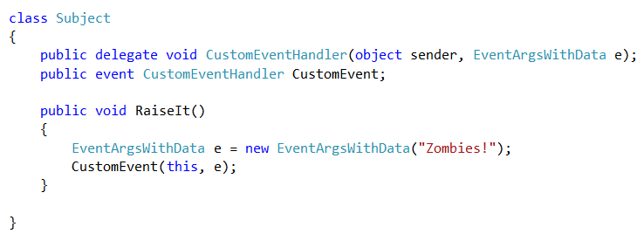
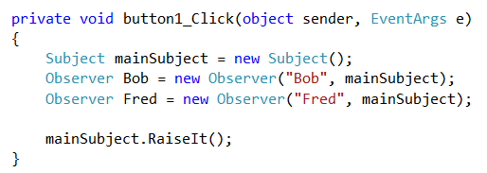
Protecting the Event
Notes:
In the example we just did, the Subject declared the event type and instance, and another class – in this case the Form -- called the Subject method in which the event was raised (put creation and event raising into a single Button Click here to make it fit on the slide).
IRL, if you raise an event and nobody has registered for it the system throws an exception.
There is actually a more standard format for this raising, that protects against that error.
In addition, there is a quite strict C# naming conventions for custom events.
Let look at those two things together to see what a typical production custom event would look like...

Slide 25
Protecting the Event
Assume an event named EventName has been declared.
The method to raise that event should look like:
public void OnEventName (any required data)
{
CustomEventArgs e = new CustomEventArgs(any required data);
if (EventName != null) // Is null if no methods have been registered
EventName(this, e);
}
Notes:
Pseudocode
Note the OnEventName convention. Users will expect each event to have an associated OnEventName method. Like you expect OnClick, OnItemSelected, OnFormLoad, etc.
Note also how you can check to make sure someone is listening for the event before you raise it. If you try to raise an event with no observers, the system throws an exception.
Here’s how this would change our Zombies application…

Slide 26
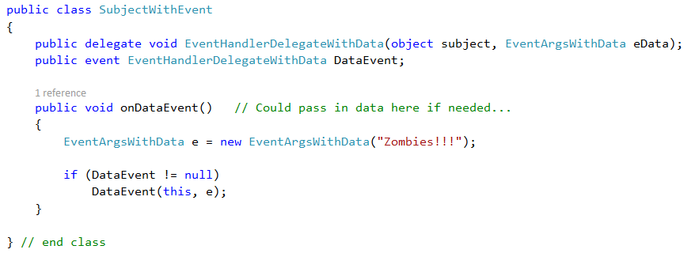
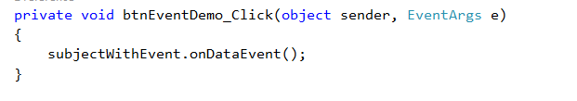
Protecting the Event
Notes:
The new OnCustomEvent methd replaces RaiseIt() and there is the appropriate error check inside
And the change to the Form call, calling the new version which follows the naming convention and checks for observers.

Slide 27
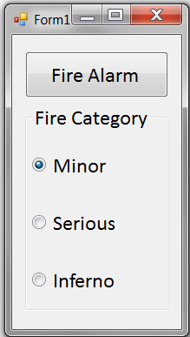
In Class Practical – The Fire Alarm
Notes:
Here’s the first example you are going to create in Practical today (in class)
When the alarm button is clicked, the application displays instructions and sounds an alarm (using the computer’s beep function), as appropriate for the class of fire. (The more serious the fire is, the more high-pitched the beep.)
We are going to build this using ourSubject/Observer pattern with custom events.
The subject monitors for fire (i.e. the button click); the observers generate output
We will have two observers: one who displays instructions, and one who sounds the alarm.
The observers will accept information about the category of the fire, and will use that to determine what instructions to present, and what sound to generate.

Slide 28
Example – The Fire Alarm
We need:
Custom EventArgs
Subject
Observers
Form Class
Notes:
Here’s the first example you are going to create in Practical today.

Slide 29
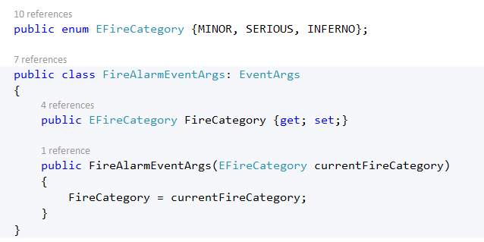
Custom EventArgs
Needs to hold the fire category

Slide 30
Subject
Defines the delegate
Defines the event
Provides the method to raise the event
The Subject will be responsible for creating the custom event args, which holds the category enum vlue.
How does the Subject know that value?
Notes:
The category is determined by which radio button is selected.
Who knows this? => The Form
So the Form must pass that information to the Subject.
You can either:
Have the subject expose a “set”method for it, or
You can pass it in as an argument to the OnWhateverTheEventIsNamed method
The second approach is preferable. Why? => The Form can’t forget to call the set method first.

Slide 31
The Observers
Expose an appropriate event handler method
Register themselves with their subject
Notes:
What sort of architecture do we need for them? => inheritance family
Why? => They have common code (in the constructor) and a polymorphic method (the event handler).

Slide 32
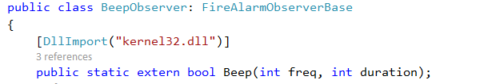
Alarm Bell Observer
Notes:
You can implement the sound however you want.
In the demo, I use the system beep. The system beep is pretty old and has been lost from modern Visual Studio in favour of its own complicated media controls.
But if you want it, you can still pull it in. Here’s how…
Just add these lines in the class.
This yanks in the Beep method from the kernel32 library.
You can then call Beep anywhere in the class, as shown. First argument is Hz; second is milliseconds
The handler method for this observer child is left to the practical.

Slide 33
Form Code
Remember: After creating the Observer instances, the Form never calls any Observer methods.
Notes:
In the practical
Just remember that in the code that is actually executed, we don’t talk directly to the Observers at all.
We created them in the Form_Load (or constructor as you prefer), but at no point do we call any of their methods.
Nonetheless, each Observer will execute his code as required when the button is clicked.
Make sure you understand why. This is the core of this pattern.

Slide 34
Demo

Slide 35
Code Frags if you get Stuck

Slide 36
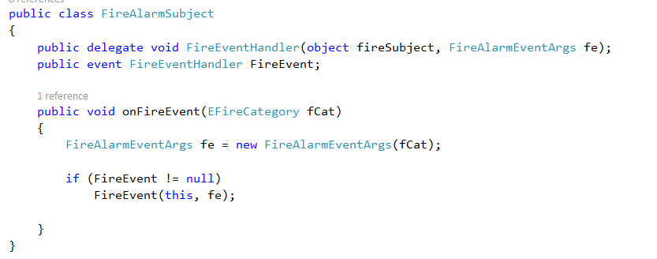
Subject
Notes:
Work through on board
The delegates for Events are always like this, remember?
Bind the event to the delegate type…
Make the methods to raise.
Note that this method expects the Form to pass it the fireCategory, which the Form will determine from inspecting the radio buttons. This keeps the Subject uncoupled from the UI, as it should be.

Slide 37
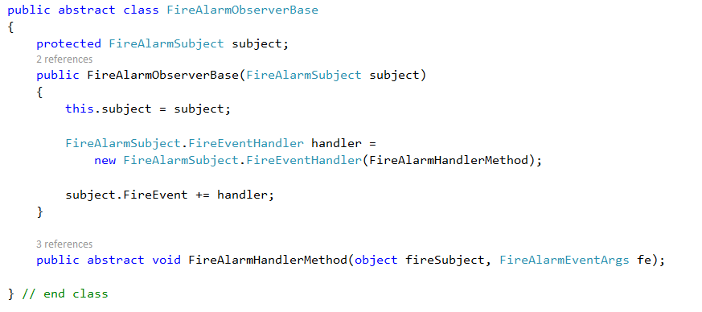
Observers
Observer base class
Notes:
Work through on board
Two observers.
Some things in common: e.g. Each has a fireHandler method, each registers that method in their constructor
Some things different: They implement their fireHandler methods completely differently.
So we need what? => An inheritance hierarchy.
Here is the base class.
NB: THE DELEGATE MUST BE FULLY QUALIFIED

Slide 38
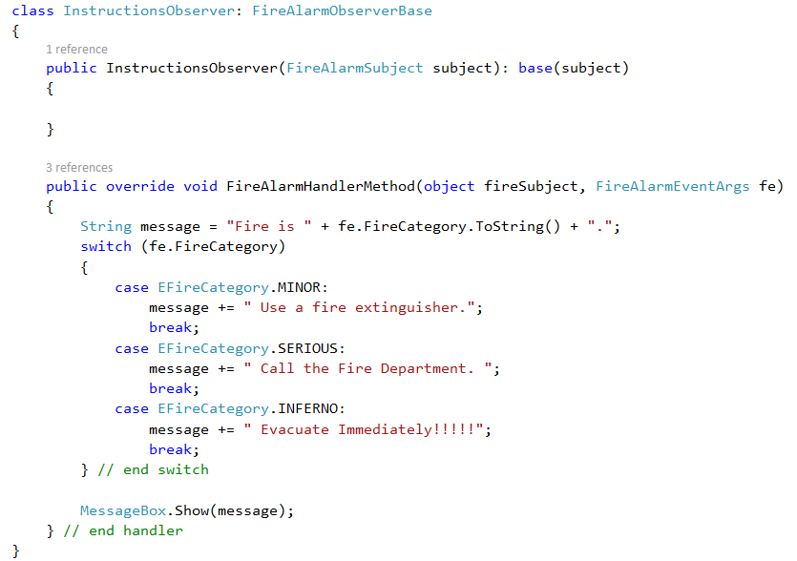
Instructions Observer
Notes:
He’ll call the parent constructor for his constructor.
Note the constructor needs only to call the parent, passing in the Subject reference. That insures correct registration (cf. that code).
He’ll implement the abstract method
Here is a very simple, brute force, hard-coded implementation, just so it will fit on the slide.
You should be able to think of various ways to make the class more flexible and extensible.
Feel free to modify in your own implementation.
In the fireHandler method, we use the special data passed in with FireEventArgs fe. This is why we make him.

